Slide 1
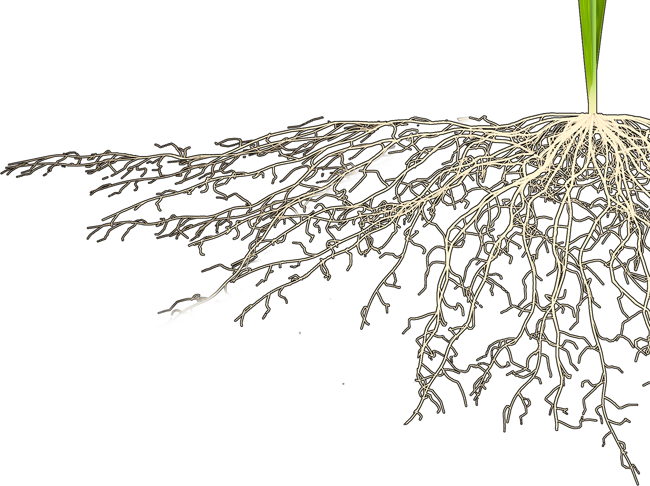
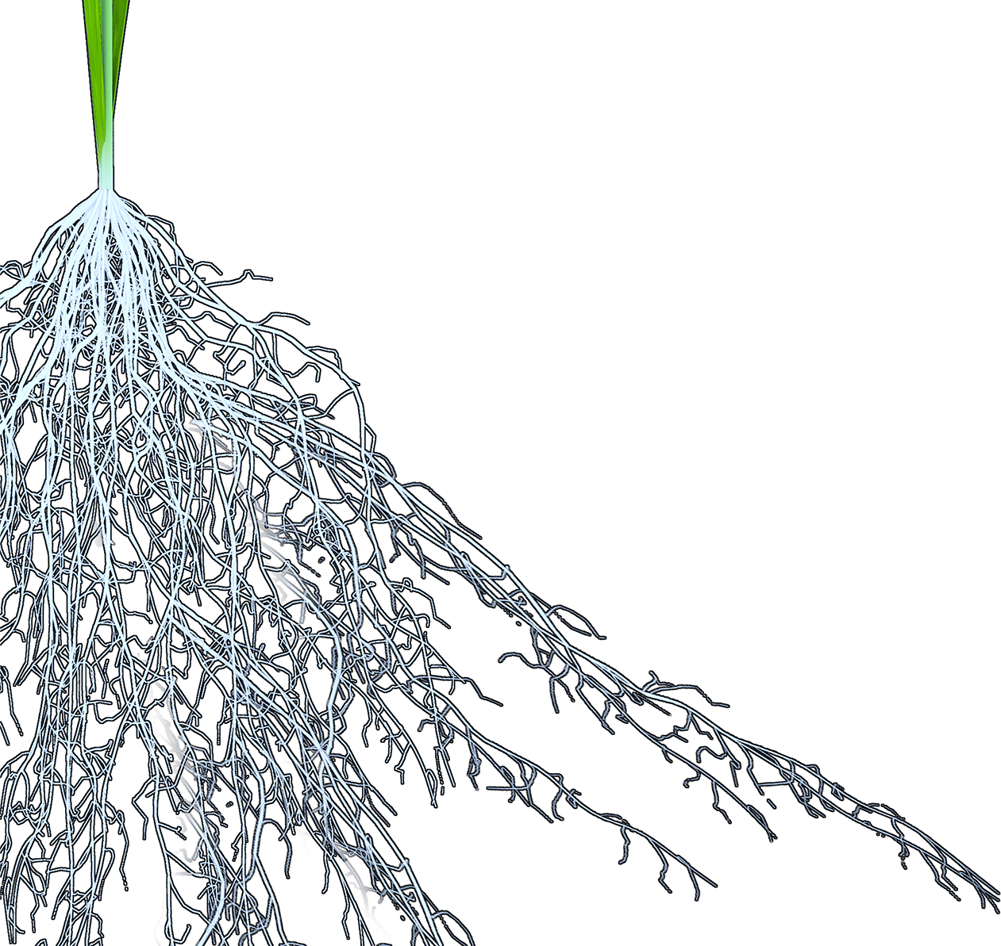
Molecular Breeding of Root System Architecture Improves Rice Yield Performance Under Deficiencies of Water and Nitrogen
Yusaku Uga
E-mail: yuga@affrc.go.jp
Institute of Crop Science, National Agriculture and Food Research Organization (NARO), Japan
16th, May, 2018

Slide 2
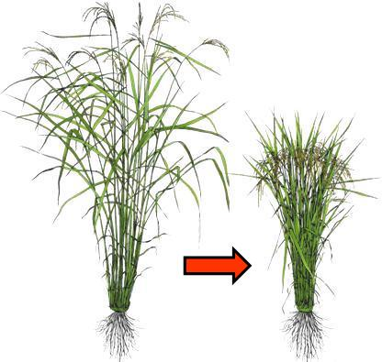
What is next Ideotype for second ‘Green revolution’ ?
?
Modified from http://www.knowledgebank.irri.org/ericeproduction/Module_0.htm

Slide 3
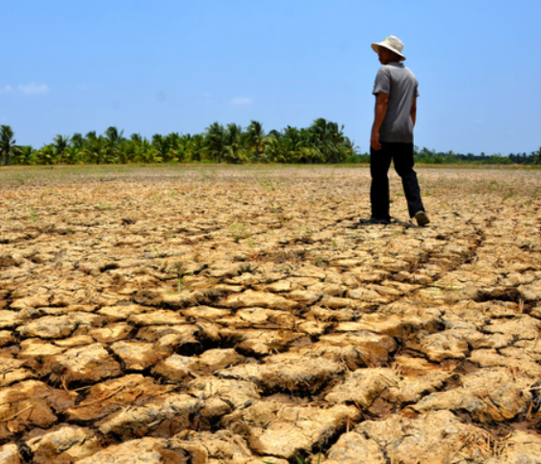
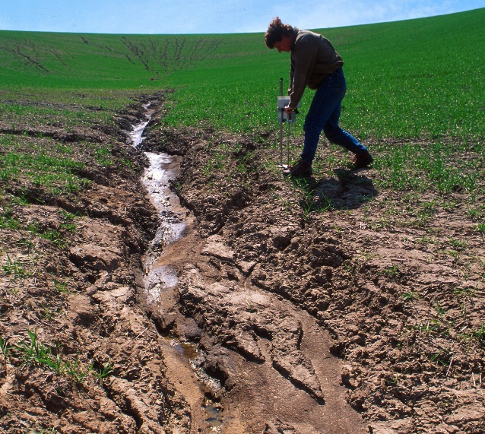
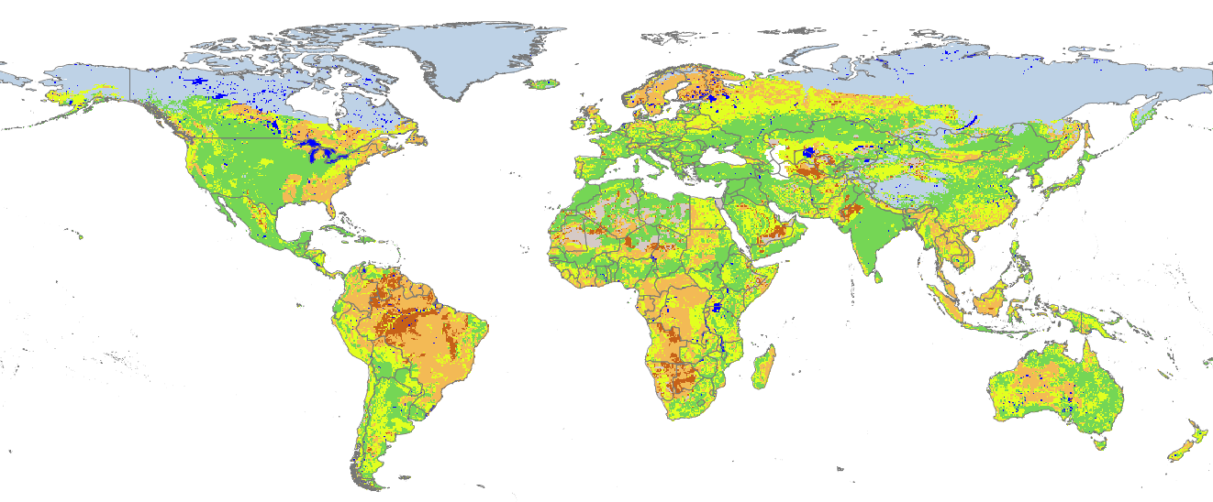
The constraint of water and nutrient availability
Drought stress
Dai (2011) WIREs Climate Change
Low soil fertility
FAO/IIASA (2011)
Climate change is accelerating unequal distribution of water and nutrients in agricultural land at a global level

Slide 4
What is next Ideotype for second ‘Green revolution’ ?
Modified from http://www.knowledgebank.irri.org/ericeproduction/Module_0.htm
Rice Today, 12 (4), 2013

Slide 5
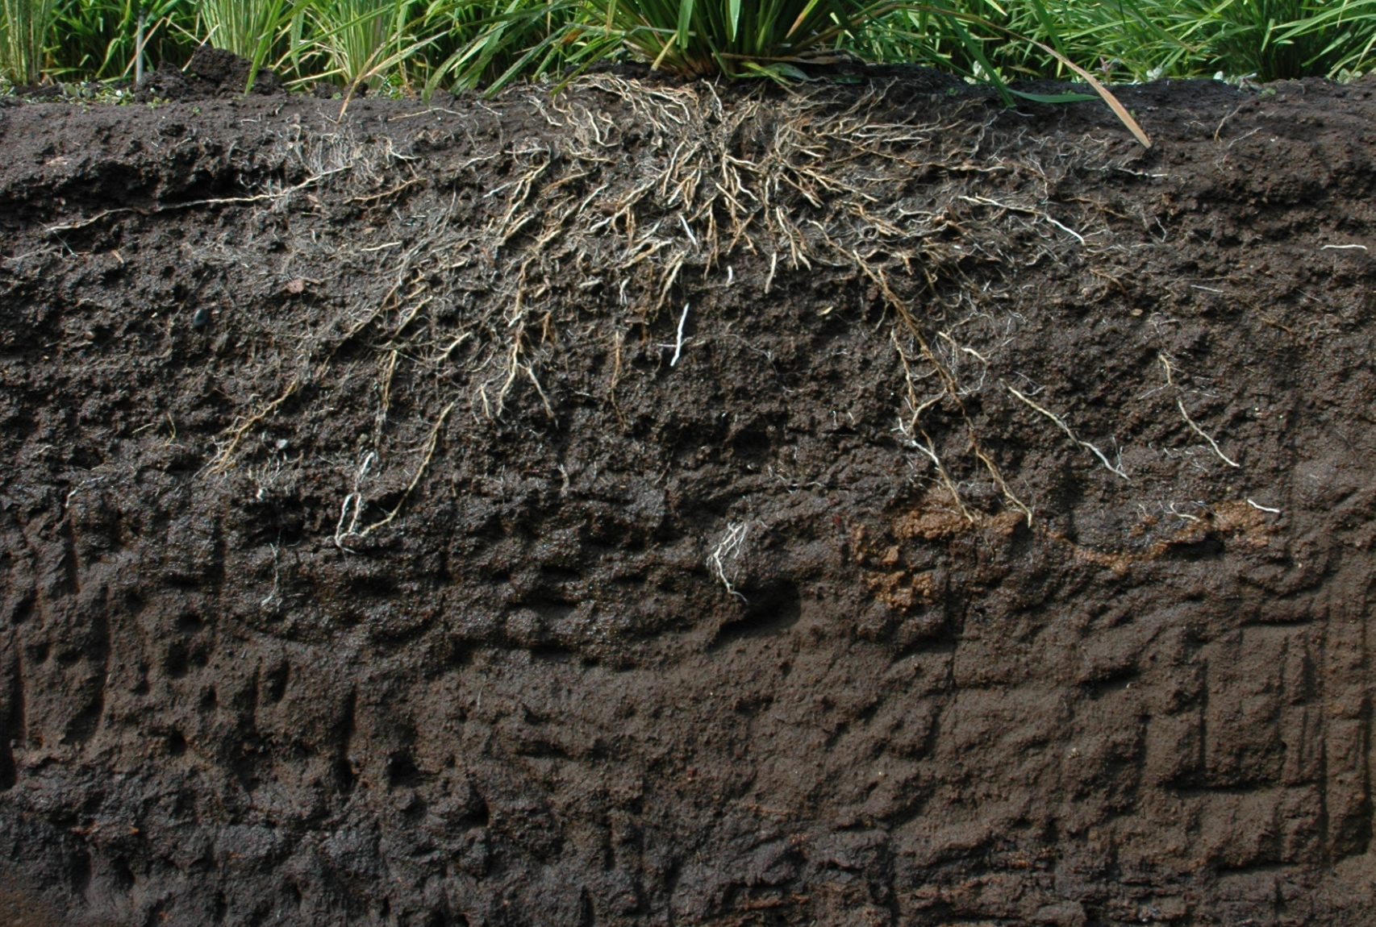
Water and nutrients are heterogeneously distributed in soil
PO₄⁻ K⁺ Mn⁺²
Ca²⁺
Mg²⁺
H₂O
Na⁺ NO₃⁻ SO₄²⁻

Slide 6
Root system architecture (RSA) determines foraging area of water & nutrients
P
P
P
P
P
P
P
P
N
N
H₂O
N
H₂O
H₂O
N
H₂O

Slide 7
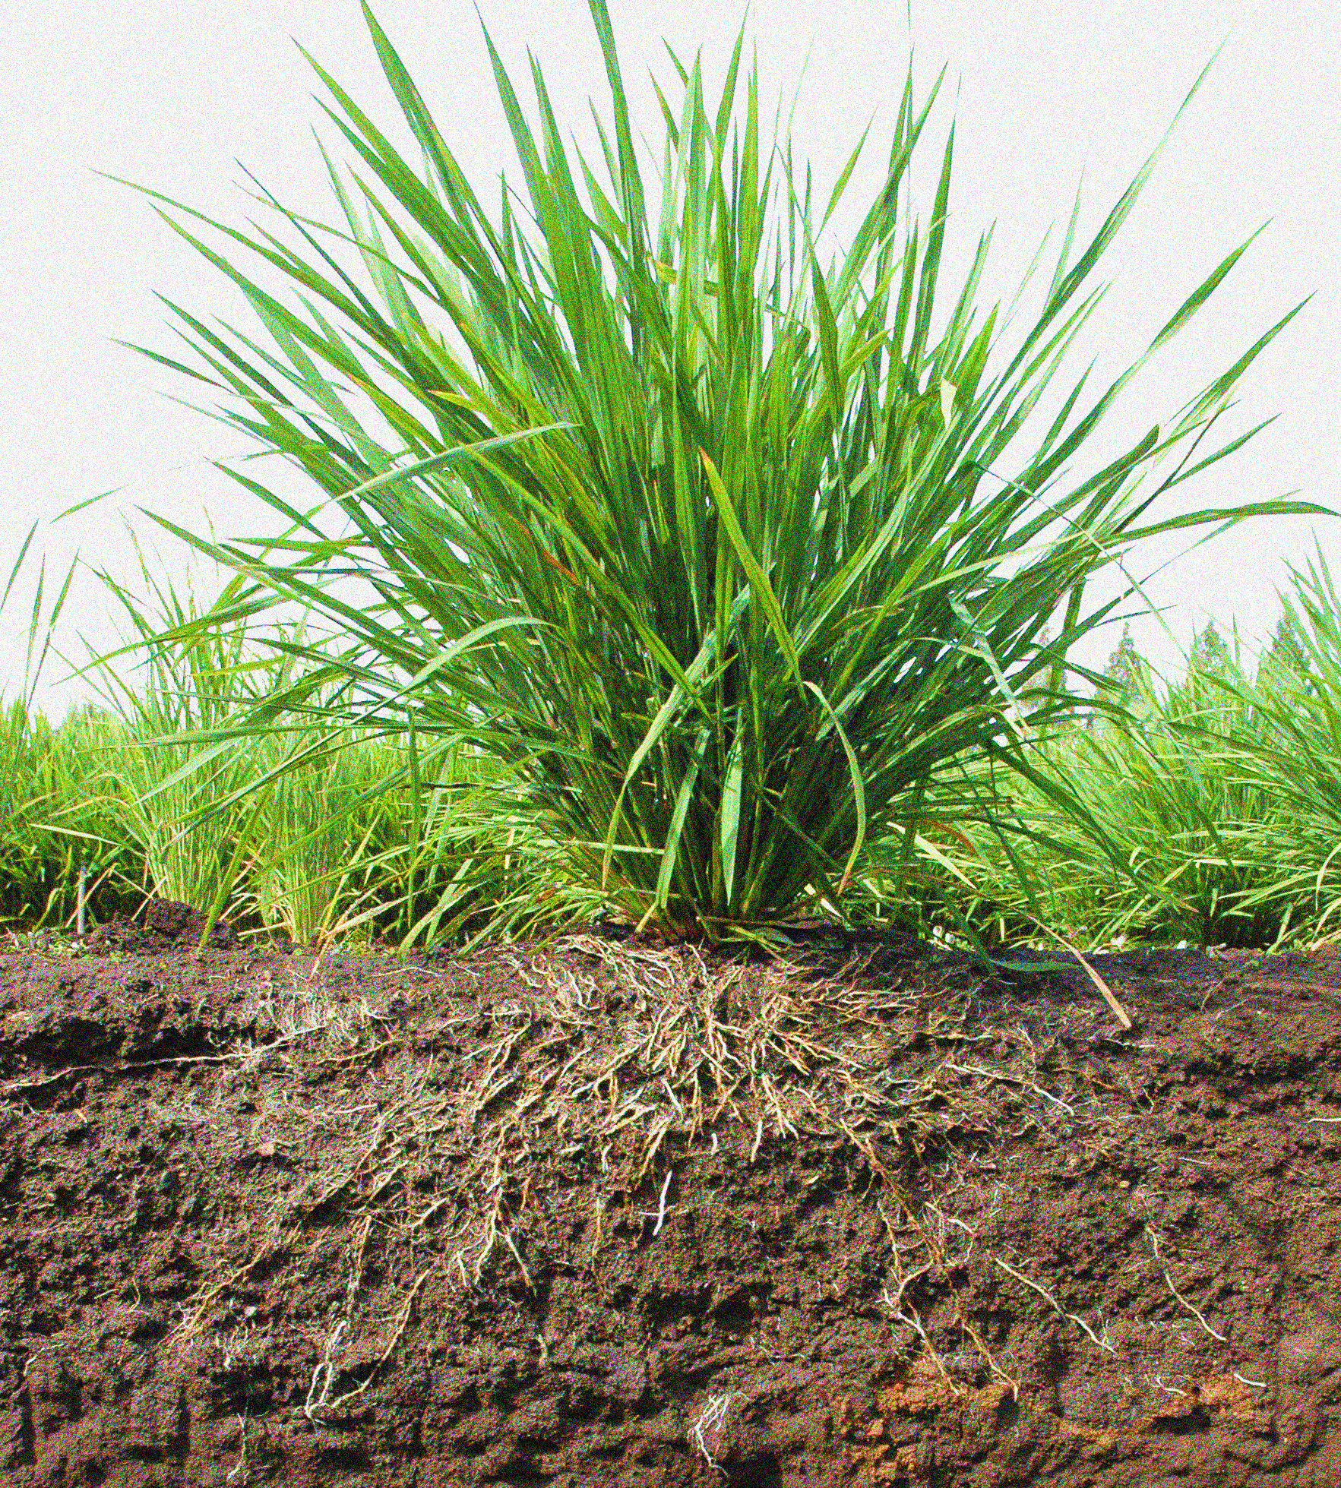
Root is exposed to several abiotic stresses in soil
Waterlogging
Salinity
Drought
Metal pollution
Nutrient deficiency & excess

Slide 8
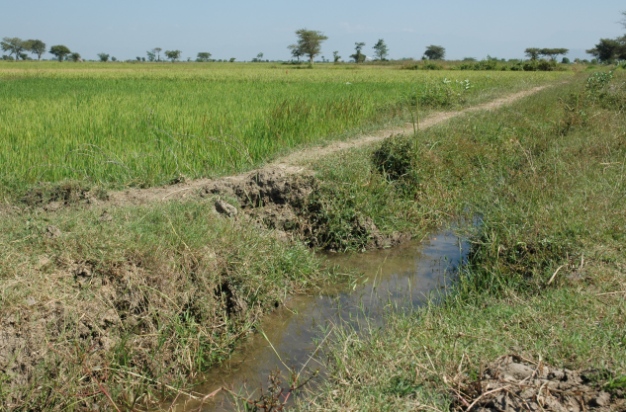
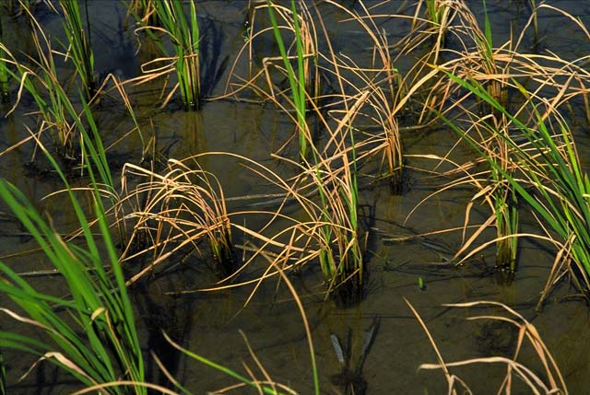
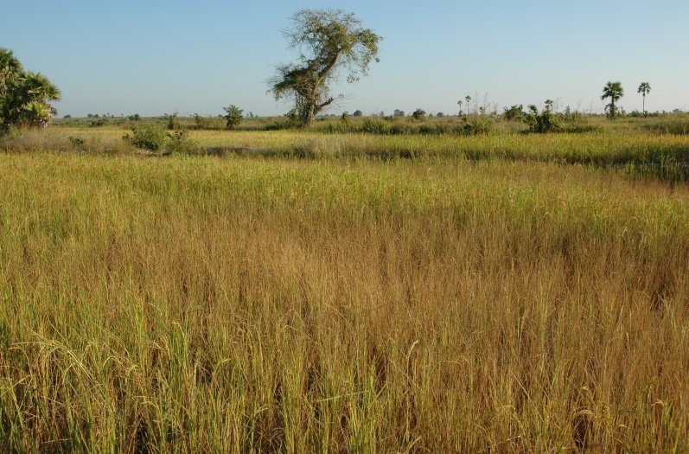
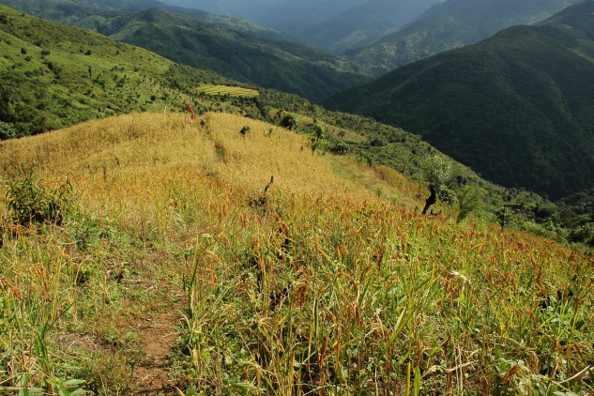
Cultivated rice (Oryza sativa L.) is grown in various environments
Coastal area (Salinity)
Irrigated lowland
http://www.knowledgebank.irri.org/decision-tools/rice-doctor/rice-doctor-fact-sheets/item/salinity
Rain-fed lowland
(Drought)
Burnt field
(Low-fertility)

Slide 9
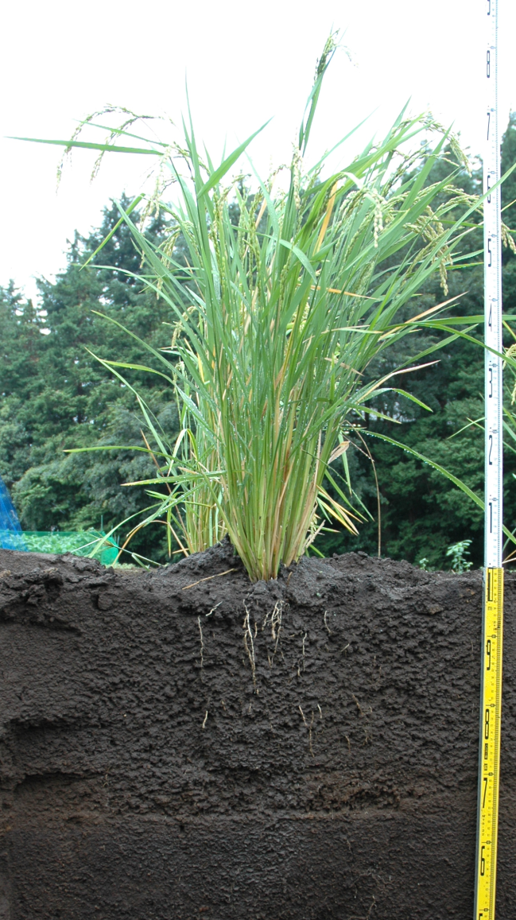
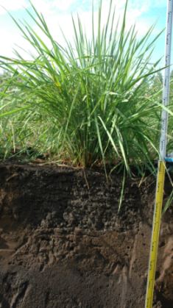
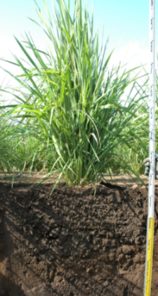
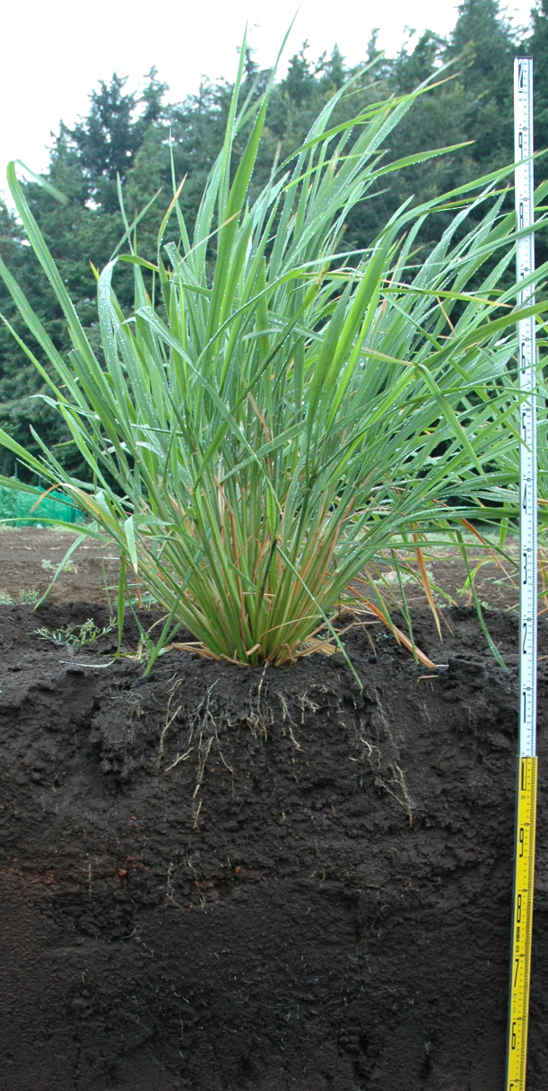
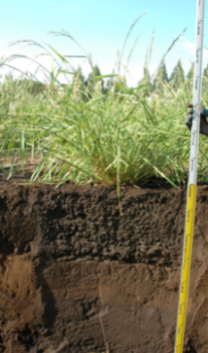
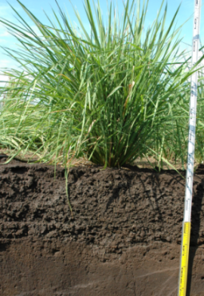
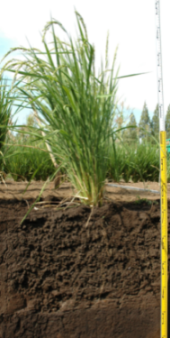
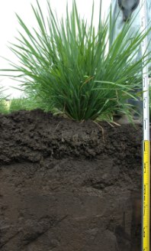
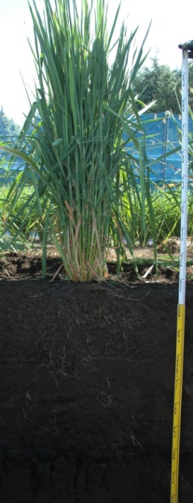
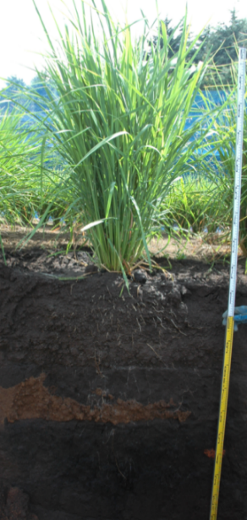
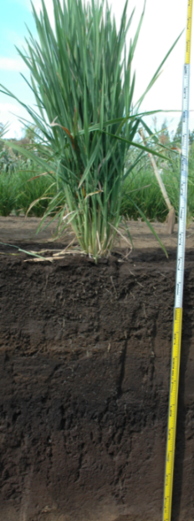
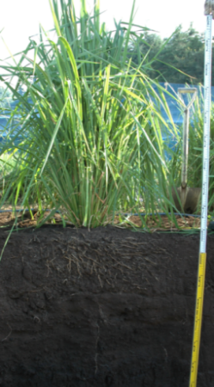
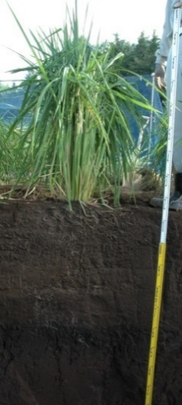
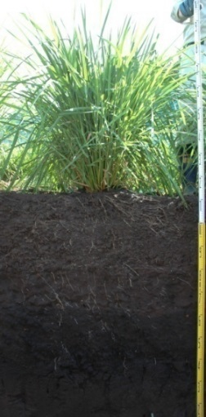
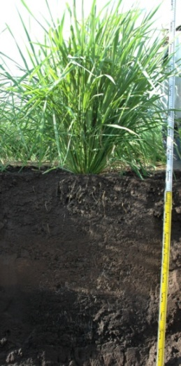
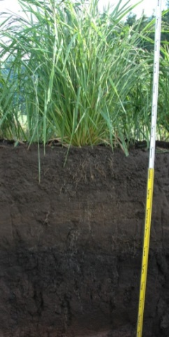
Rice may have wide diversity of RSA for adaptation to environments
IR64
Sasanishiki
Shuusoushu
Bei Khe
Deng Pao Zhai
Naba
Koshihikari
Gemdjah Beton
Bleiyo
Khao Nam Jen
Kau Mac Kho
Basilanon
Tupa 121-3
Muha
Shoni
Kinandang Patong
White shaded area and outermost white dotted line indicate major and maximum root distributions, respectively.

Slide 10
Utilization of natural variation in RSA may be useful
for improving stress avoidance as well as water & nutrients uptake
P
P
P
P
P
P
P
P
N
N
H₂O
N
H₂O
H₂O
N
H₂O

Slide 11
Case studies:
Does steeper root growth angle (RGA) contribute to rice production?

Slide 12
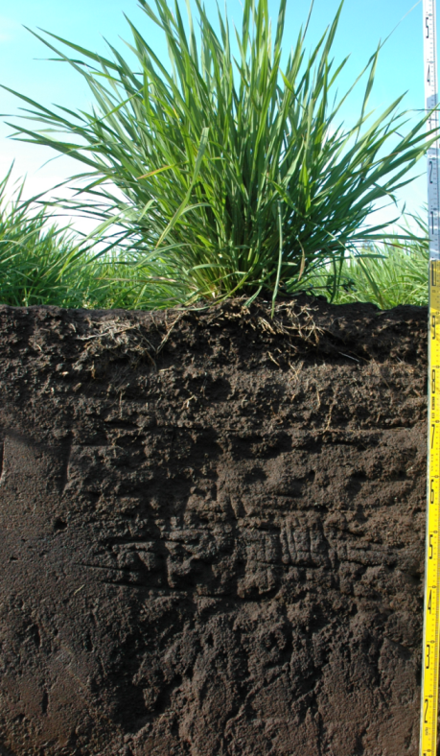
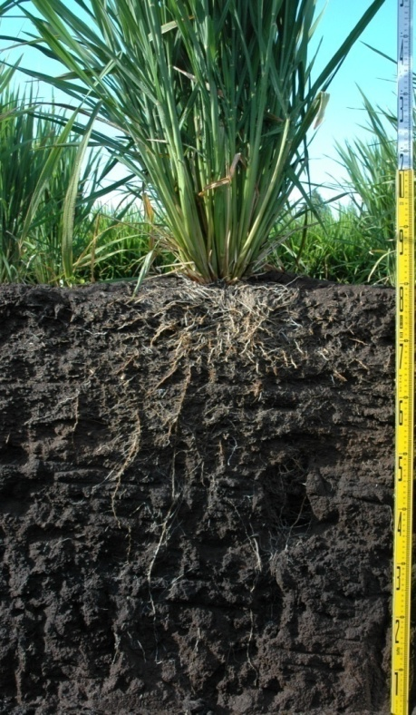

Development of deep-rooting rice from shallow-rooting rice
Genes for root traits
Lowland rice (IR64)
High yield
Drought susceptible
Upland rice (Kinandang Patong)
Low yield
Drought resistance

Slide 13

Identification of target gene is needed for genetic improvement
Genes for root traits
Where is target gene?

Slide 14
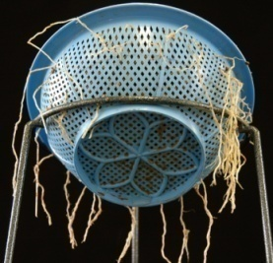
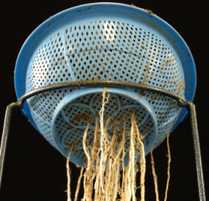
DRO1 (DEEPER ROOTING 1) on chr. 9 identified in IR64xKP RILs
Chr 1
Chr 2
Chr 3
Chr 4
Chr 5
Chr 6
Chr 7
Chr 8
Chr 9
Chr 10
Chr 11
Chr 12
RM3252
RM7451
ID06_17
RM6659
ID13_33
S15909
RM481
RM1019
RM3609
RM7361
E30794
ID12_17
S13774
ID08_30
RM5799
ID12_23
RM1353
RM444
ID11_41
ID07_34
ID03_25
ID09_43
ID06_50
RM5348
RM1
S42
RM5647
ID07_40
RM19
RM279
RM3397
RM585
ID07_04
RM167
C60206
ID13_50
S20922
ID07_07
RM5622
C12115
S21074
RM251
RM11
LOD = 26.9
R² = 66.6%
AE = 16.1%
ID12_38
RM8077
ID07_12
RM1261
RM289
ID07_14
RM25425
RM7463
RM519
C10987
RM3794
RM5432
ID07_17
RM271
RM5824
RM580
OSR9A
ID11_10
E60275
E61552
RM7488
RM336
RM229
ID13_15
S1864
RM430
ID05_47
RM6990
RM242
IR64
RM3291
RM3524
RM164
RM1309
RM201
RM459
C53905
RM3689
ID06_11
S13623
RM341
RM252
E60663
RM505
RM6283
RM3
ID12_14
RM206
RM235
S5756
RM262
RM7395
RM234
E21191
RM17
ID09_04
R10253
RM6976
ID08_22
RM470
RM224
RM263
RM3513
RM303
E30531
RM144
RM526
RM3276
R3879
RM3817
ID11_21
RM248
RM16
RM6845
E864
ID04_11
S5470
RM3155_1
RM520
C11635
E60168
ID11_26
ID11_29
RM494
RM5448
RM406
KP
RM3810
ID11_35
RM6840
Uga et al. (2011) JXB

Slide 15
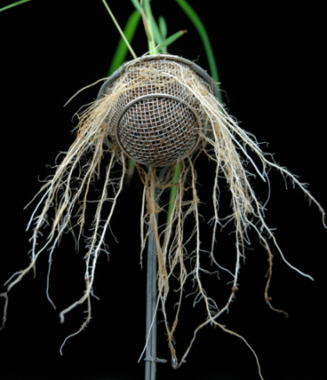
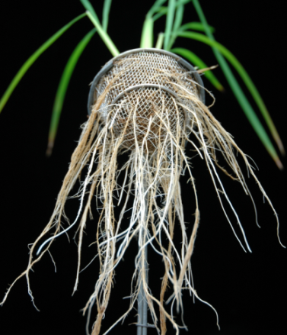
Positional cloning of DRO1
Structure of DRO1
ATG
(KP) T
C (IR64)
TAA
1bp deletion (IR64)
70
a
a
a
60
50
b
40
Ratio of deep rooting (%)
30
20
c
d
cd
10
d
0
IR64
NIL
#11
#28
#43
#21
#27
#173
Vc
KPg
(P < 0.05, Tukey's HSD test)
#28 (Vc)
#27 (KPg)
Ratio of deep rooting in transgenic rice
Uga et al. (2013) Nature Genet.

Slide 16
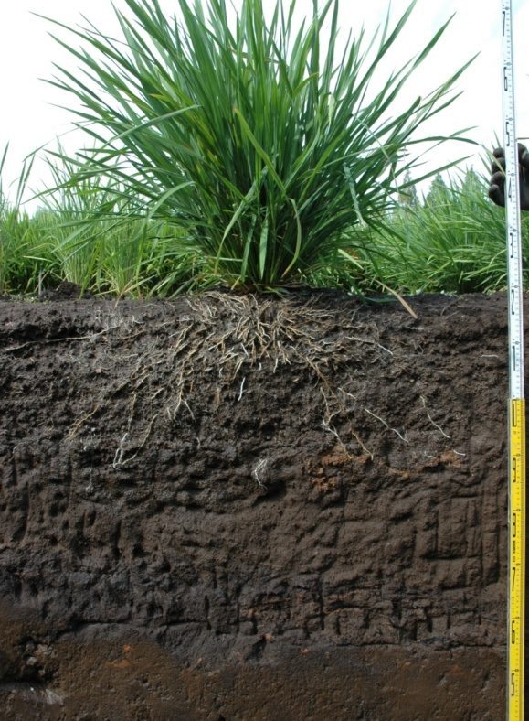
DRO1 showed a huge effect on RGA
IR64
Dro1-NIL
Kinandang Patong (KP)
1
2
3
4
5
6
7
8
9
10
11
12
1
2
3
4
5
6
7
8
9
10
11
12
1
2
3
4
5
6
7
8
9
10
11
12
DRO1(-)
DRO1(+)
DRO1(+)
0cm
40 cm
40 cm
20cm
40cm
80 cm
60cm
Uga et al. (2013) Nature Genet.

Slide 17
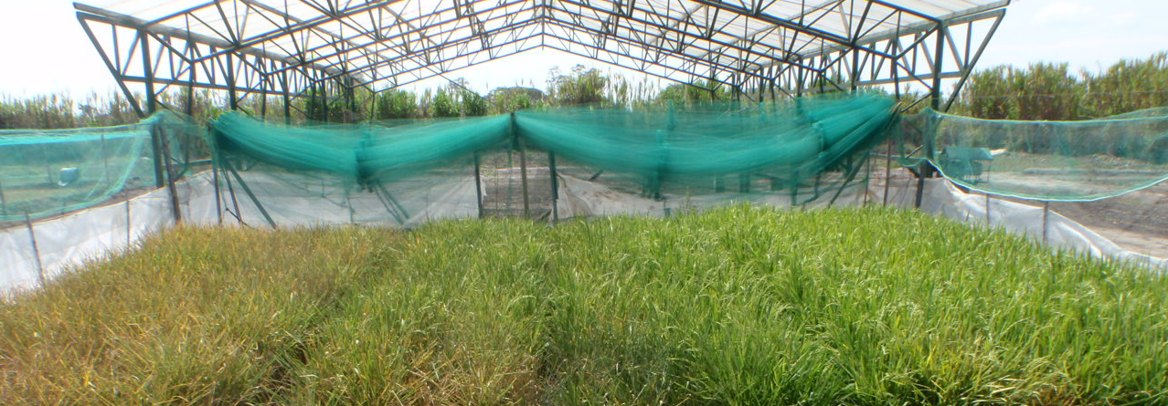
DRO1 performance in different drought conditions (CIAT in Colombia)
Rainout shelter
Boom irrigation system
Drought gradient field
No drought
Moderate drought
Severe drought
100
100
100
90
90
90
80
80
80
70
70
70
Soil moisture (%)
60
60
60
50
20 cm below ground
50
50
40
40 cm below ground
40
40
30
60 cm below ground
30
30
20
50
55
60
65
70
75
80
85
90
95
20
50
55
60
65
70
75
80
85
90
95
20
50
55
60
65
70
75
80
85
90
95
Days after sowing
Days after sowing
Days after sowing
Time course of soil moisture in different soil layers of the no, moderate, and severe drought condition blocks under a rainout shelter.
Uga et al. (2013) Nature Genet.

Slide 18
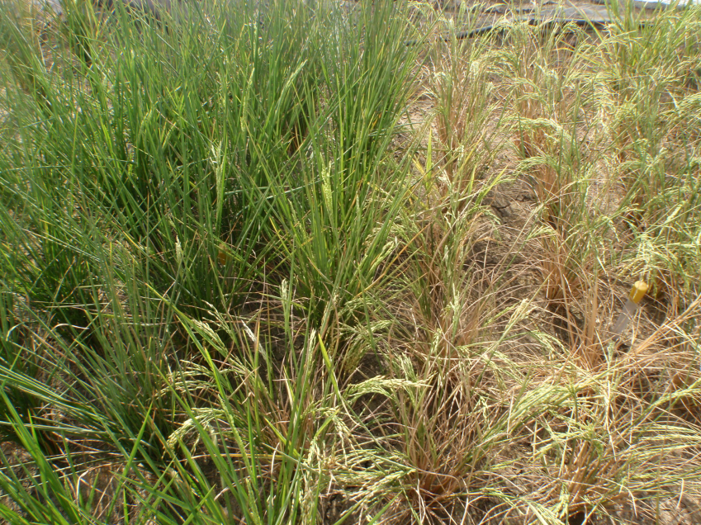
DRO1 increased yield in drought stress conditions
35
n. s.
IR64
30
2.0-fold
Dro1-NIL
25
20
Grain weight per plant (g)
15
3.6-fold
10
IR64
Dro1-NIL
5
Severe-drought plot at 27 DAT
0
No
drought
Moderate
drought
Severe
drought
Uga et al. (2013) Nature Genet.

Slide 19
Steeper RGA by DRO1 improves drought avoidance
DRO1(+)
DRO1(-)
H₂O
H₂O
H₂O
H₂O
H₂O
H₂O

Slide 20
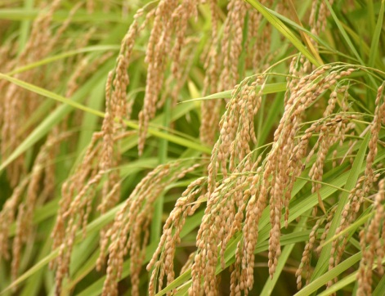
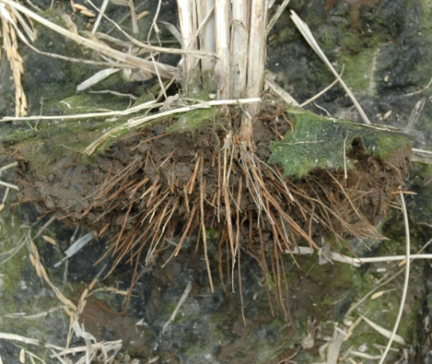
Does difference of RGA affect yield performance in paddy fields?
Biomass & Yield
Photosynthesis
Nitrogen & water uptake
Cytokinin synthesized in roots
Root system

Slide 21
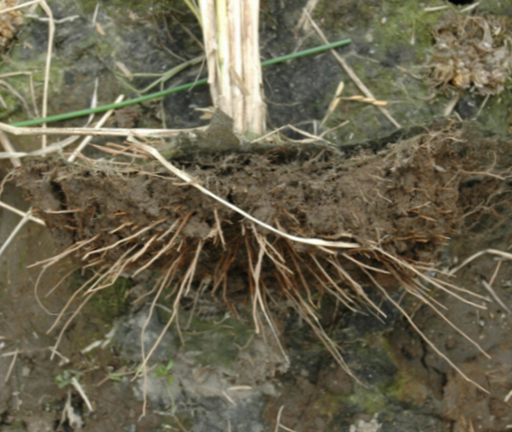

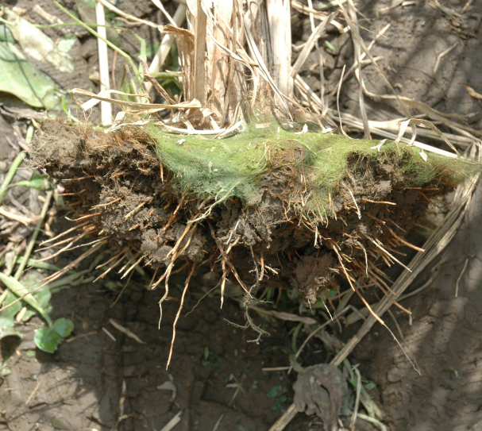
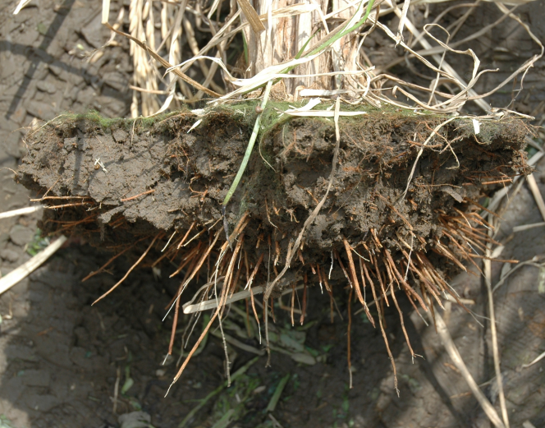
Dro1-NIL showed steeper RGA than IR64 in a paddy fields with or without nitrogen treatments
Nitrogen (-)
Nitrogen (+)
IR64
Dro1-NIL

Slide 22
Dro1-NIL showed approximately 10% higher grain yield than IR64, irrespective of nitrogen treatments
Panicle No.
Shoot dry weight (g)
Total grain weight (g)
Yield (t/ha)
Treatment
Line
Mean
S.D.
Mean
S.D.
Mean
S.D.
Mean
IR64
256
±
19
ª
1149.8
±
176.5
ª
498.0
±
44.8
ª
4.1
Nitrogen
(-)
Dro1-NIL
237
±
4
1238.7
±
64.3
551.6
±
39.2
ª
4.7
ª
ª
NIL/IR64 (%)
92.6
107.7
110.8
112.9
IR64
343
±
10
^{b}
1908.6
±
60.0
^{b}
929.1
±
17.7
^{b}
8.0
Nitrogen
(+)
Dro1-NIL
363
±
23
2051.5
±
67.2
1051.0
±
28.2
^{c}
8.8
^{b}
^{b}
NIL/IR64 (%)
105.7
107.5
113.1
110.9
Mean: n = 3 plots, 24 samples/plot, S.D: standard deviation.
Values labeled with different letters differ significantly among the three lines (P <0.05, Student’s t test).
Arai-Sanoh et al. (2014) Sci. Rep.

Slide 23
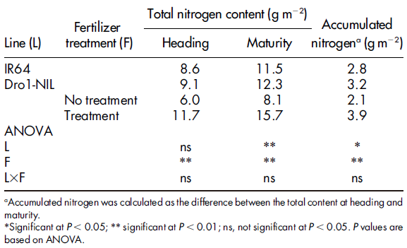
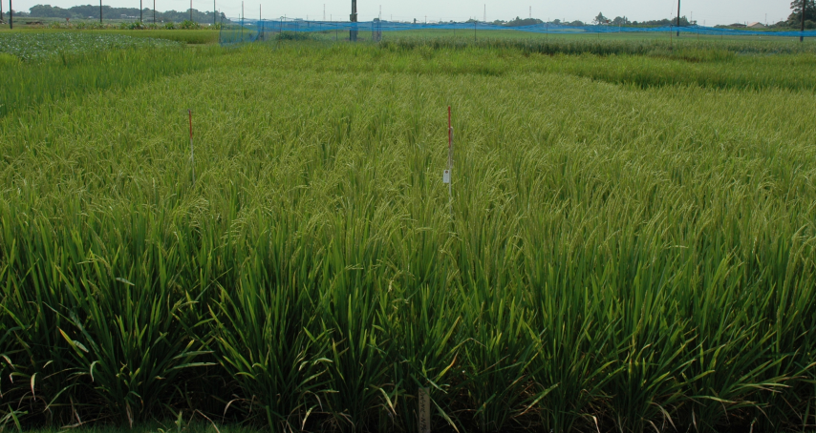
After heading, uptake of nitrogen from soil was higher in Dro1-NIL than in IR64
Nitrogen content of whole plants
IR64
Dro1-NIL
Arai-Sanoh et al. (2014) Sci. Rep.

Slide 24
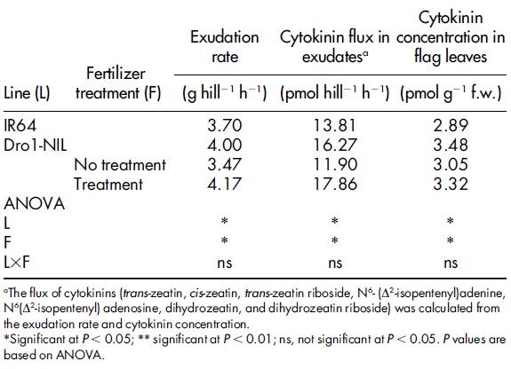
After heading, Dro1-NIL maintained higher cytokinin fluxes from roots to shoots than IR64
Exudation rate and mean cytokinin flux in exudates, cytokinin concentration in flag leaves at 14 days after heading
Arai-Sanoh et al. (2014) Sci. Rep.

Slide 25
Steeper RGA by DRO1 enhances nitrogen uptake, resulting in better grain filling
DRO1(-)
DRO1(+)
NH₄⁺
NH₄⁺
NH₄⁺
NH₄⁺
NH₄⁺
NH₄⁺
NH₄⁺
NH₄⁺

Slide 26
Ideotype breeding of “RSA” could provide various benefits to improve rice production
IR64
Dro1-NIL
IR64
Dro1-NIL
IR64
Dro1-NIL
Cd²⁺
Cd²⁺
Cd²⁺
Cd²⁺
Cd²⁺
Cd²⁺
Cd²⁺
NH₄⁺
NH₄⁺
NH₄⁺
Cd²⁺
Cd²⁺
H₂O
NH₄⁺
H₂O
H₂O
H₂O
H₂O
NH₄⁺
NH₄⁺
NH₄⁺
NH₄⁺
non-bioavailable Cd
Drought avoidance
(Water uptake)
Grain filling
(Nitrogen uptake)
Heavy metal avoidance
Uga et al. (2013) Nature Genet.
Sanoh et al. (2014) Sci. Rep.
Uga et al. (2015) Breed. Sci.
Kumar et al. (Unpublished data)

Slide 27
What is next ideal RSA for efficient uptake of water & nitrogen?
+ RGA QTLs
+ Root length QTLs
+ RGA QTLs
?
?
N
N
N
H₂O
H₂O
N
N
N
H₂O
H₂O
N
H₂O
H₂O
H₂O
N
H₂O
N
Vertical root distribution = Maximum root length x Root growth angle (RGA)

Slide 28
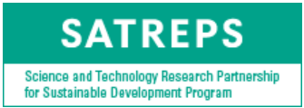
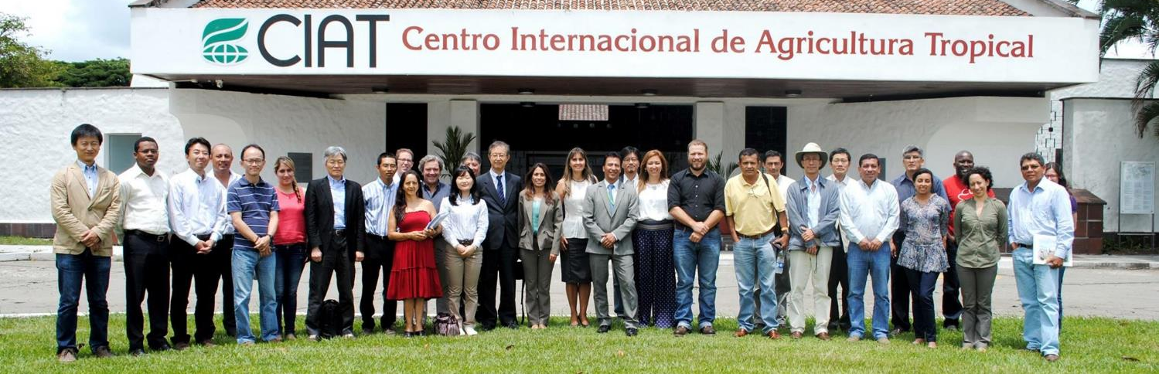









Development and Adoption of Latin American Low-input Rice Production System Through Genetic Improvement and Advanced Field-management Technologies

Slide 29





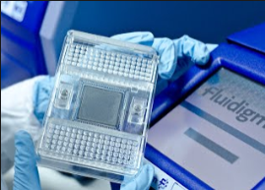
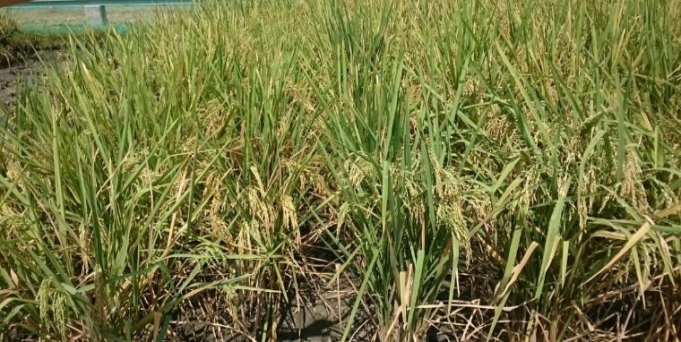
Our mission: Development of new rice varieties with higher WUE and NUE by using root QTLs in Colombia
Parental lines:
FEDEARROZ 60
FEDEARROZ 174
FEDEARROZ 473
CT21375
Colombian Variety
Kinandang Patong
×
F₁
×
SNP analysis
BC₁F₁
×
SNP analysis
BC₂F₁
×
SNP analysis
BC₃F₁
BC₃F₂
FEDEARROZ 60
BC₃F₁

Slide 30
Utilization of chromosomal segment substitution lines (IK-CSSLs) to identify QTLs for ‘root length’ in rice
KP
×
IR64
1
2
3
4
5
6
7
8
9
10
11
12
SL1001
SL1002
IR64
×
F₁
SL1003
MAS (Marker-assisted selection)
SL1004
BC₁F₁
×
IR64
SL1005
(7 lines)
SL1006
MAS
SL1007
BC₂F₁
×
IR64
SL1008
(14 lines)
MAS
SL1009
SL1010
BC₃F₁
×
IR64
SL1011
(20 lines)
MAS
SL1012
SL1013
BC₄F₁
SL1014
(25 lines)
SL1015
MAS
SL1016
BC₄F₂
SL1017
(27 lines)
SL1018
MAS
SL1019
SL1020
BC₄F₃
SL1021
(30 lines)
SL1022
MAS
SL1023
SL1024
BC₄F₄
SL1025
(26 CSSLs)
SL1026
Uga et al. (2015) Rice

Slide 31
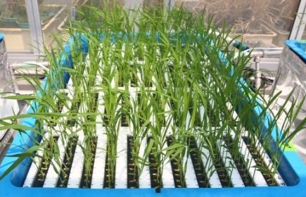

Root length of 26 IK-CSSLs grown in hydroponic conditions
14
Chr. 6
Chr. 2
Chr. 5
Chr. 8
12
Chr. 7
10
8
Maximum root length (cm)
6
4
2
0
KP
IR64
SL1001
SL1002
SL1003
SL1004
SL1005
SL1006
SL1007
SL1008
SL1009
SL1010
SL1011
SL1012
SL1013
SL1014
SL1015
SL1016
SL1017
SL1018
SL1019
SL1020
SL1021
SL1022
SL1023
SL1024
SL1025
SL1026
Kitomi et al. (2018) G3

Slide 32
QRO1&2 (Quick Rooting 1&2) identified on chromosomes 2&6
2S
RM19951 (12.98)
6S
RM1161 (13.75)
RM262 (20.80)
RM20048 (16.10)
RM5427 (21.52)
RM3762-1 (22.46)
RM5651 (23.57)
RM6318 (24.43)
RM3 (19.50)
RM6617 (24.77)
RM6107 (25.28)
QRO1
RM1942 (25.32)
RM1920 (25.47)
RM5314-1 (24.84)
RM1307 (25.83)
RM5371 (25.83)
RM13679 (26.11)
RM6395 (26.00)
RM7245 (26.45)
RM20471 (26.00)
RM7511 (26.61)
RM6274 (26.32)
RM526 (26.67)
RM20495 (26.55)
RM5631 (28.27)
RM20517 (27.11)
QRO2
RM3430-1 (27.43)
RM20557 (27.46)
RM20580 (27.91)
RM20595 (28.09)
6L
C11635 (28.09)
2L
E60168 (32.86)
RM1370 (28.53)
RM7286 (33.00)
RM6811 (29.23)
RM5404 (33.68)
RM5463-1 (30.99)
RM494 (31.09)
Kitomi et al. (2018) G3

Slide 33

QTL cloning for RSA is needed for Ideotype breeding of hidden half
1
2
3
4
5
6
7
8
9
10
11
12
Sta1
DRO1
DRO4
DRO3
qSOR1
QRO1
DRO2
QRO2
qCRL1
DRO5
Root growth angle
qSOR1: Uga et al. (2012) TAG
DRO1: Uga et al. (2013) Nature Genet.
DRO2: Uga et al. (2013) Sci. Rep.
DRO3: Uga et al. (2015) Rice
DRO4 & DRO5: Kitomi et al. (2015) Rice
Root length
qCRL1: Uga et al. (2018) BMC Genomics
QRO1 & QRO2: Kitomi et al. (2018) G3
Root thickness
Sta1: Uga et al. (2010) Mol. Breed.
Cloned QTL
Fine-mapped QTL
Mapped QTL

Slide 34








Genetic interaction between qSOR1 and DRO1
1
2
3
4
5
6
7
8
9
10
11
12
1
2
3
4
5
6
7
8
9
10
11
12
1
2
3
4
5
6
7
8
9
10
11
12
1
2
3
4
5
6
7
8
9
10
11
12
[IR64]
[IR64]
[IR64]
[IR64]
DRO1
DRO1
dro1
dro1
qSOR1
qsor1
qSOR1
qsor1
DRO1(+)/qSOR1(+)
DRO1(+)/qSOR1(-)
DRO1(-)/qSOR1(+)
DRO1(-)/qSOR1(-)
10 cm
Kitomi et al. (Preparation)

Slide 35
The whole picture of the genetic network in RSA is not well understood
Gravistimulation
Auxin signaling
ARF protein(s)
DRO2
qSOR1
DRO1
?
DRO3
(Columella cells)
(DEZ)
?
DRO4
?
?
Polar auxin transport
DRO5
?
Cell division or elongation
DRO2: Uga et al. (2013) Sci. Rep.
DRO3: Uga et al. (2015) Rice
DRO4&DRO5: Kitomi et al. (2015) Rice
Asymmetric root growth
Root bending

Slide 36
What is perfect RSA for improving rice production in sterile and unstable soil environments?
Weak variety
Robust variety
Decreased yield (↓)
Stable yield (→)
For crops, it’s undesirable to allocate more resources to the roots for survival like wild species.
STRESS
STRESS
Undesirable RSA for sterile soil con.
Desirable RSA
for sterile soil con.

Slide 37
















Development of climate-resilient crops by employing ROOTomics
(CREST project, Grant Number JPMJCR17O1, Oct. 2017 ~ Mar. 2023)
Concept: ROOTomics will allow for the modeling of an ideal root system architecture that is robust to environmental stress, and based on this model, we aim to develop climate-resilient crops.
Development of root phenotyping platform
Visualization of roots in the soil using X-ray CT scanner
Modeling based on ROOTomics
Uga Group
Root phenomics
Model validation in fields
Kawakatsu Group
Hayashi Group
Weak plants
Robust plants
Robust plants
Ideal root system
Transcriptome dynamics
Genetic basis of root traits
Modeling
Database construction
Modeling of ideal root system that is robust to environmental stress
ROOTomics: root-related multi-omics data
Tanabata Group
Model validation in natural fields
Phenotyping platform
Image analysis
Model validation
Climate-resilient crops

Slide 38

Development of non-destructive 3D root phenotyping platform using X-ray CT
1. Large growth chamber with controlled temperature, humidity & illuminance
2. Automatic measuring system of soil water content and temp. by environmental sensors
3. Automatic control of soil moisture content and temp. based on data obtained from sensors
4. Non-destructive 3D image analysis for
root system in soil
by X-ray CT
5. 3D image analysis for aerial part of plants by multi-camera system

Slide 39

Modeling of ideal root system based on ROOTomics and its validation in natural fields
1. Acquisition of ROOTomics
in multiple environmental stresses & its database construction
2. Development of stress biomarkers monitoring plant stress response
3. Modeling of ideal root system based on ROOTomics
4. Model validation in natural fields
Development of climate-resilient crops

Slide 40



















Many thanks to all of you!!
Kumar A., Henry A., Singh A., Leung H.
Tanabata T.
Kashihara M., Kum R.
Inukai Y.
Dr. Teramoto
Kawachi N., Suzui N., Ishii S., In E., Yamaguchi M., Kurita K., Nagao Y., Miyoshi Y., Hase Y.
Dr. Kitomi
Ando T., Arai-Sanoh Y., Endo M., Fukuoka S., Hara N., Hayashi T., Inoue H., Ishikawa S., Kanno N., Kawai S., Kawakatsu T., Kondo M., Matsumoto T., Nakano H., Nagamura Y., Nishijima R. Mizubayashi T., Motoyama R., Ono K., Sugimoto K., Takai T., Takehisa H., Tanaka T., Wu J., Yamamoto E., Yano M., Yoshinaga S.
Kojima M., Sakakibara H.
Hanzawa E., Sato T.
Nakao E., Irie K.
Ookawa T., Okura M
Ishitani M., Selvaraj M., Tohme J., Valencia M.
Ogawa S.
McCouch S., Assaranurak I.
Kochian L., Larson B., Craft E., Shaff J.
Guzman P., Bayer N., Amezquita N.
Funders: Our works are supported by JST/JICA SATREPS (Japan), JST CREST (JPMJCR17O1, Japan), JSPS KAKENHI (#23380189, Japan), Japan Tobacco Inc., Yamada Science Foundation (Japan), & MAFF (QTL4003 & RBS2009, Japan).

